Slide 1

DEOGIRI INSTITUTE OF ENGINEERING & MANAGEMENT STUDIES
Computer Science & Engineering Department
Project Report On
implementation of deterministic finite automata (DFA)
Subject- Theory of computer
Submitted By
Aarvi Vinod Kale(36167)
Dipak Kaluse (36168)
Under The Guidance Of
Prof.Sarika chavan mam

Slide 2
Content -
Introduction of DFA
What is DFA
Parts of DFA
Example of DFA
Real life applications of DFA

Slide 3
Introduction to DFA
Theoreticians have developed number of theoretical models to describe computing
Simplest model is known as DFA
Deterministic : machine will in a state .
Finite : the machine will be have certain number of states.
Automaton : machine , robot.

Slide 4
What is DFA –
output
output
output
DFA’s recognize string.
Input string Output
String
“Accept” or “reject”
Finite Automaton

Slide 5
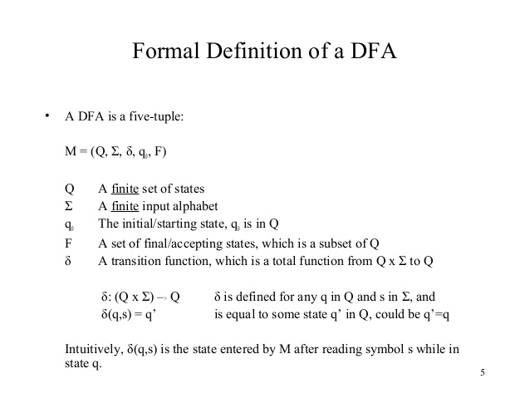

Slide 6
Parts of DFA -
Initial state (q0)
Final state (q1)

Slide 7
Example of DFA accepting string PQQ-
Input – {q,p}
q0 = q0
Final→ q3
q0=initial states
q1=string end with p
q2 =string end with pq
q3 =string end with pqq

Slide 8
Transition table -
states | Q | P
q0 | q0 | q1
q1 | q2 | q1
q2 | q3 | q1
q3 | q0 | q1

Slide 9
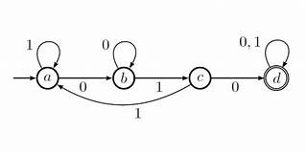
Transition diagram -

Slide 10
Real life applications of DFA -
Coke machine
Thermostats (fridge)
Elevators
Train track switches
Lexical analyzers for parsers

Slide 11
Conclusion -
Hence , we are studied DFA for accepting string PQQ .

Slide 12
Thank you ..

